Slide 1

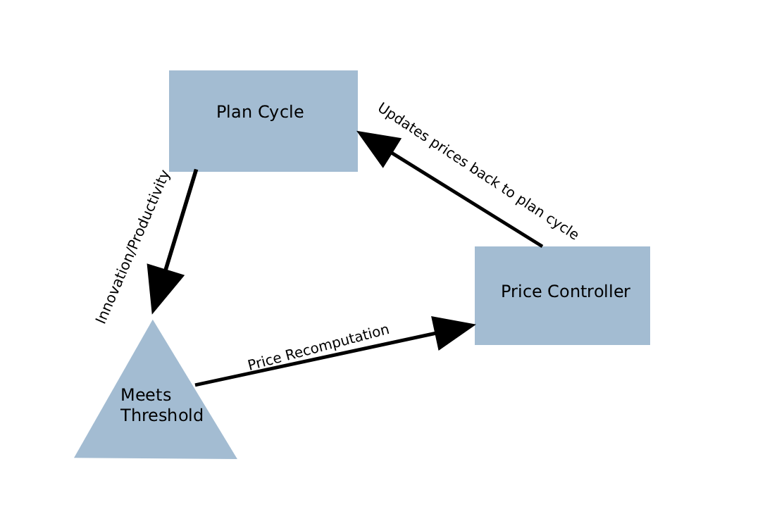
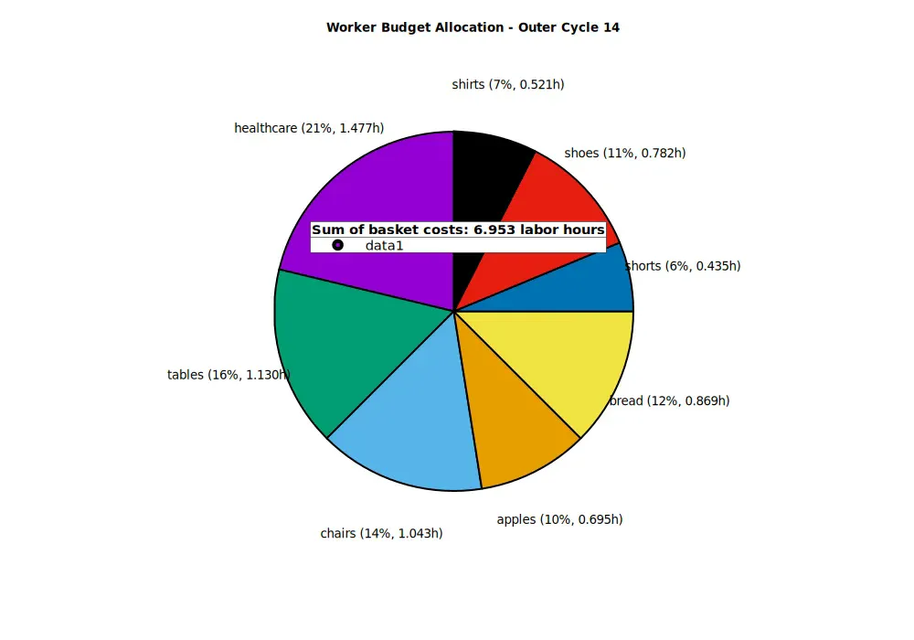
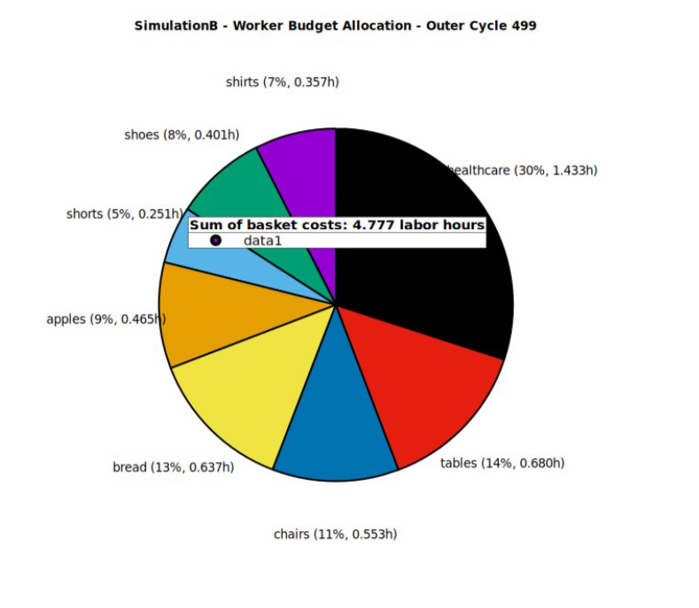
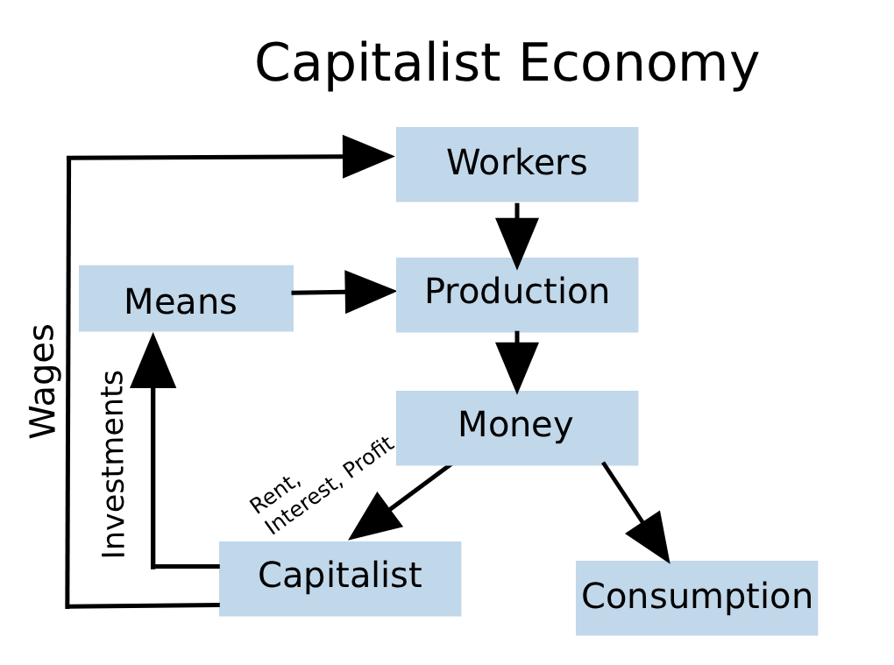
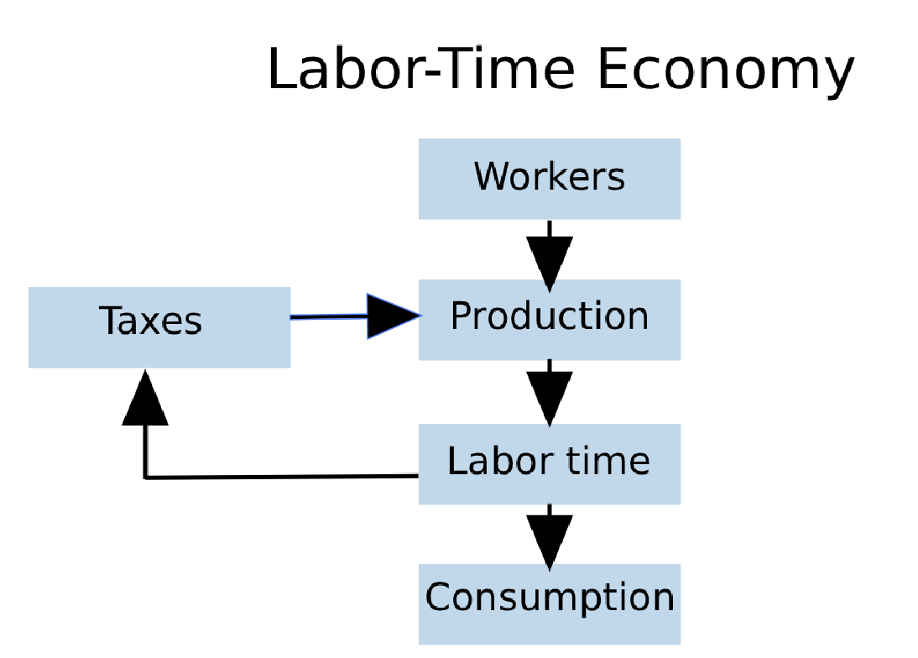
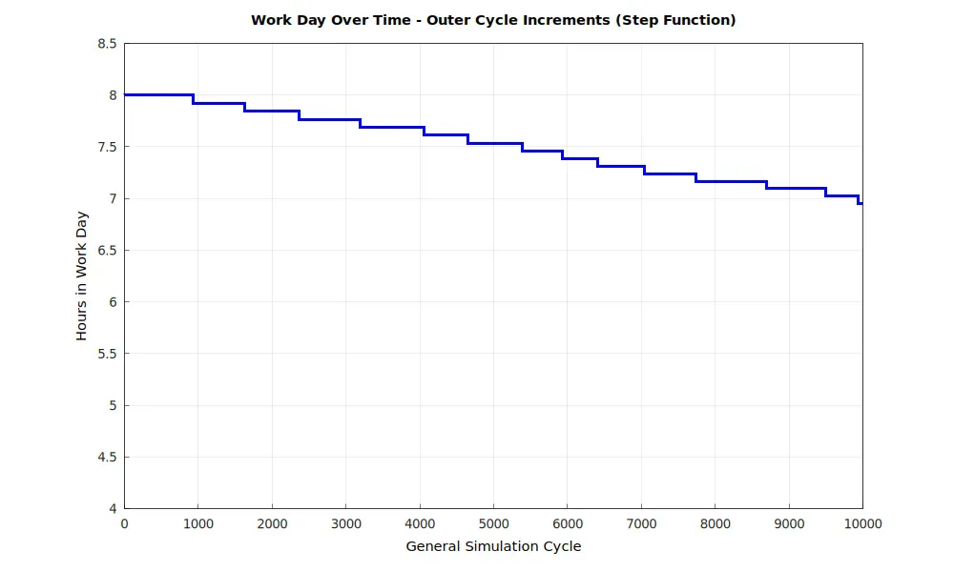
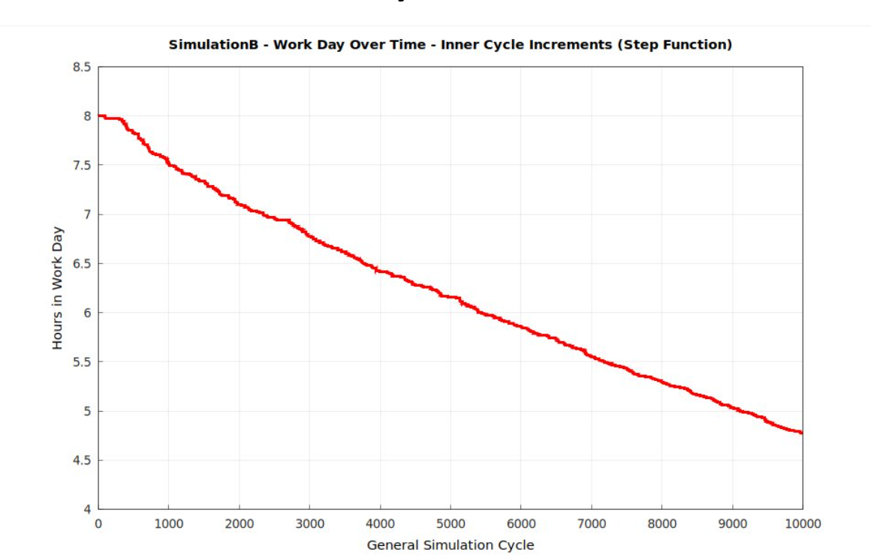
Sharing Productivity Benefits in a Labor-Time Economy
Salamun Nuhin*. Advisors: Alexander Creiner*, Ivan Williams**, Amittai Aviram* (*Boston College, **UMass)
Background
Methods
Results
The capitalist productivity paradigm creates a fundamental contradiction: worker innovations primarily benefit capital owners, while innovators face job insecurity through layoffs and work intensification. This creates perverse incentives where workers rationally resist productivity improvements to preserve employment, asking "Why should I innovate myself out of a job while enriching others?"
Current economic structures misalign individual worker incentives with collective productivity goals, resulting in suboptimal innovation rates and economic inefficiency.
Through agent-based simulation modeling, this research examines a labor time economy, where workers are paid in labor-time credits, which they turn in for consumption, with no credits diverted to profits. Productivity gains translate directly to workers through decreased labor requirements while maintaining full compensation, creating positive incentives for continuous improvement and shared prosperity.
The central challenge is designing economic conditions that encourage productivity improvements without penalizing workers in more efficient sectors. While Toyota's production system shows that workers naturally contribute innovations without direct financial incentives, labor-time economies face the problem of workers losing purchasing power when their required hours decrease due to productivity gains.
Two solutions are investigated: (a) whenever an innovation reduces required labor time for any product, that product's price is immediately reduced accordingly; (b) workers in a sector with productivity improvements continue to receive credits according to the previously necessary labor time, and prices are readjusted only after enough different sectors have similar productivity gains.
The research uses multi-agent simulation modeling 8 sectors over 10,000 cycles (27 years) with Toyota production parameters. Innovation follows Poisson distribution (15% base probability, 1% variance) generating 1-20% productivity improvements, with price recomputation triggered when ≥4 firms achieve ≥4% efficiency gains.
The research question is determining which approach maintains both innovation incentives and economic stability while preventing purchasing power disparities between sectors.
The simulation reveals critical differences between controlled and uncontrolled productivity distribution. Under price recomputation, workers maintain stable purchasing power as hours decline from 8.0 to 7.0 over 10,000 cycles while budget allocation stays balanced across sectors.
Without price recomputation, significant disparities emerge. Workers in high-productivity sectors see hours drop from 8.0 to under 5.0, but their budget allocation becomes skewed. Healthcare becomes disproportionately expensive relative to reduced labor time, creating affordability crises for workers in other sectors who have less purchasing power due to fewer hours.
With price controls, basket costs remain manageable (6.953 hours in cycle 14 versus 8.000 initially), maintaining proportional access to goods. Without controls, basket costs drop to 4.777 hours but create a two-tier system where less productive sector workers cannot afford the same living standards, especially for healthcare.
This validates proposed solution (b) (occasional price recomputation): coordinated price recomputation prevents purchasing power fragmentation that would undermine labor-time economy equity. The controlled mechanism successfully distributes productivity benefits across the workforce rather than concentrating advantages in specific sectors.
References
Goktepe, Gokhan. "Job Turnover, Patents and Human Capital." IESE Insight, 2023, www.iese.edu/insight/articles/job-turnover-patents-human-capital/.
IdeaWake. "The Success of Toyota's Employee Suggestion Program." IdeaWake, 2023, ideawake.com/the-success-of-toyotas-employee-suggestion-program/.
Kesting, Peter, and Jens Kappe. "Getting the Measure of Employee-Driven Innovation and Its Workplace Correlates." ResearchGate, 2020, www.researchgate.net/publication/339584385_Getting_the_Measure_of_Employee-Driven_Innovation_and_Its_Workplace_Correlates_Employee-Driven_Innovation.
Kim, Cheol Young. "Innovation Resistance Among Vulnerable Workers: Evidence from Korean Workplace Panel Data." SAGE Open, vol. 14, no. 3, 2024, journals.sagepub.com/doi/full/10.1177/21582440241271176.
Martinsson, Gustav. "Innovation, Productivity and Patent Quality: Micro Evidence from Swedish Manufacturing." arXiv, 22 Oct. 2022, arxiv.org/abs/2210.04102.
Toivanen, Otto, and Lotta Väänänen. "Innovation and Labor Markets." Science Direct, vol. 27, 2023, www.sciencedirect.com/science/article/abs/pii/S0927539823001020.

